Slide 1
Life Insurance and retirement Valuation

Slide 2
Canvas
Introduction to the Learning Management System (LMS)

Slide 3
Welcome
Welcome to the LMS (Canvas), you should have received your sign on details and can now access the material and resources for the subject you are studying. The LMS is also the key form of communication with your tutors. If you have any problems with access, please contact education@actuaries.asn.au
The LMS contains :
Orientation session information.
Course administration documents – general information on how to navigate the LMS , subscribing to forums and other course related documents.
Inbox –this is the main communication forum used by the Institute to inform students of course related information including upcoming events, forum participation reminders and any notifications.
A course calendar showing upcoming events.
Course notes and readings.
Assignment.
A discussion forum.
Tutorials section for tutorial materials and slides, recordings and dial in information.
Access to past exams.
You can also connect with other students directly, ask questions of each other and organise study groups.

Slide 4
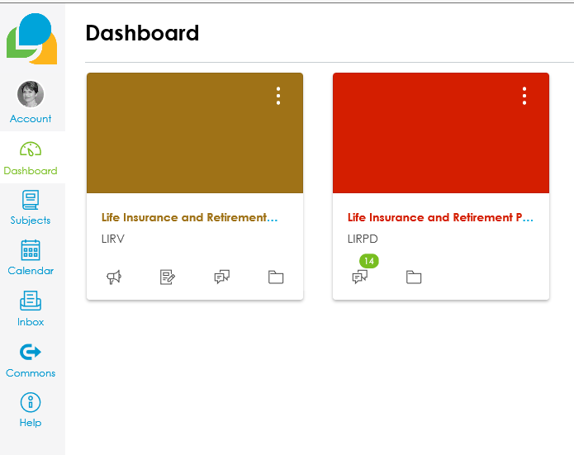
Dashboard
Here you can see
The subjects you have access to
Your calendar
Inbox
Account details where you can import your photo and set up some personal details

Slide 5
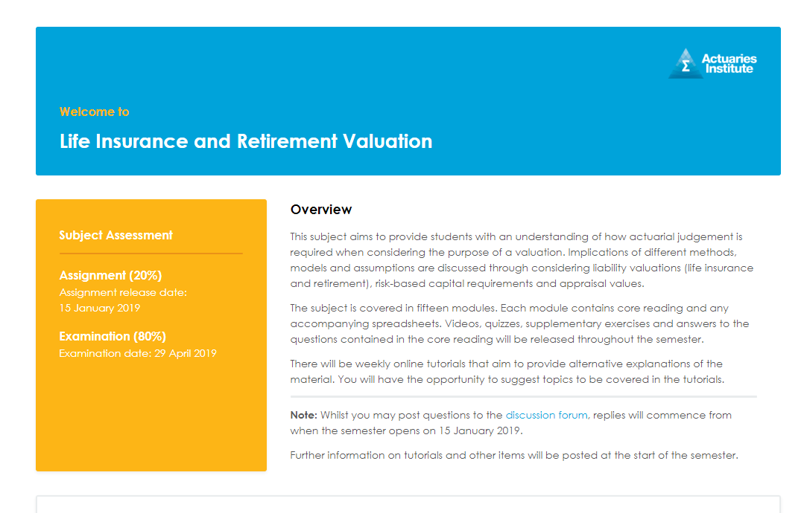
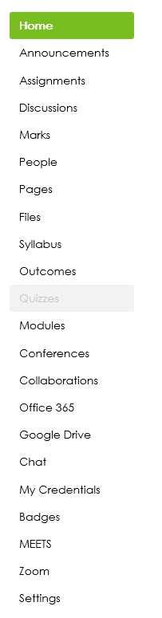
Navigating your Subject

Slide 6
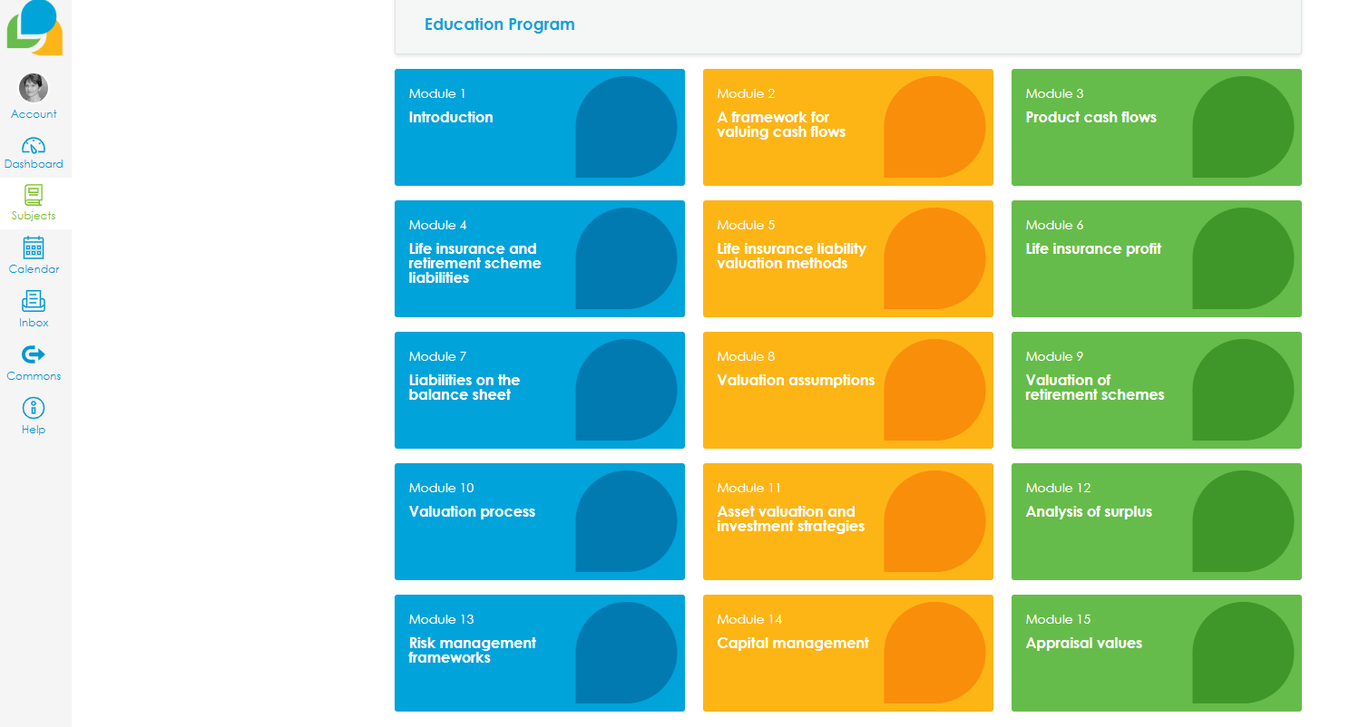
Accessing Modules

Slide 7
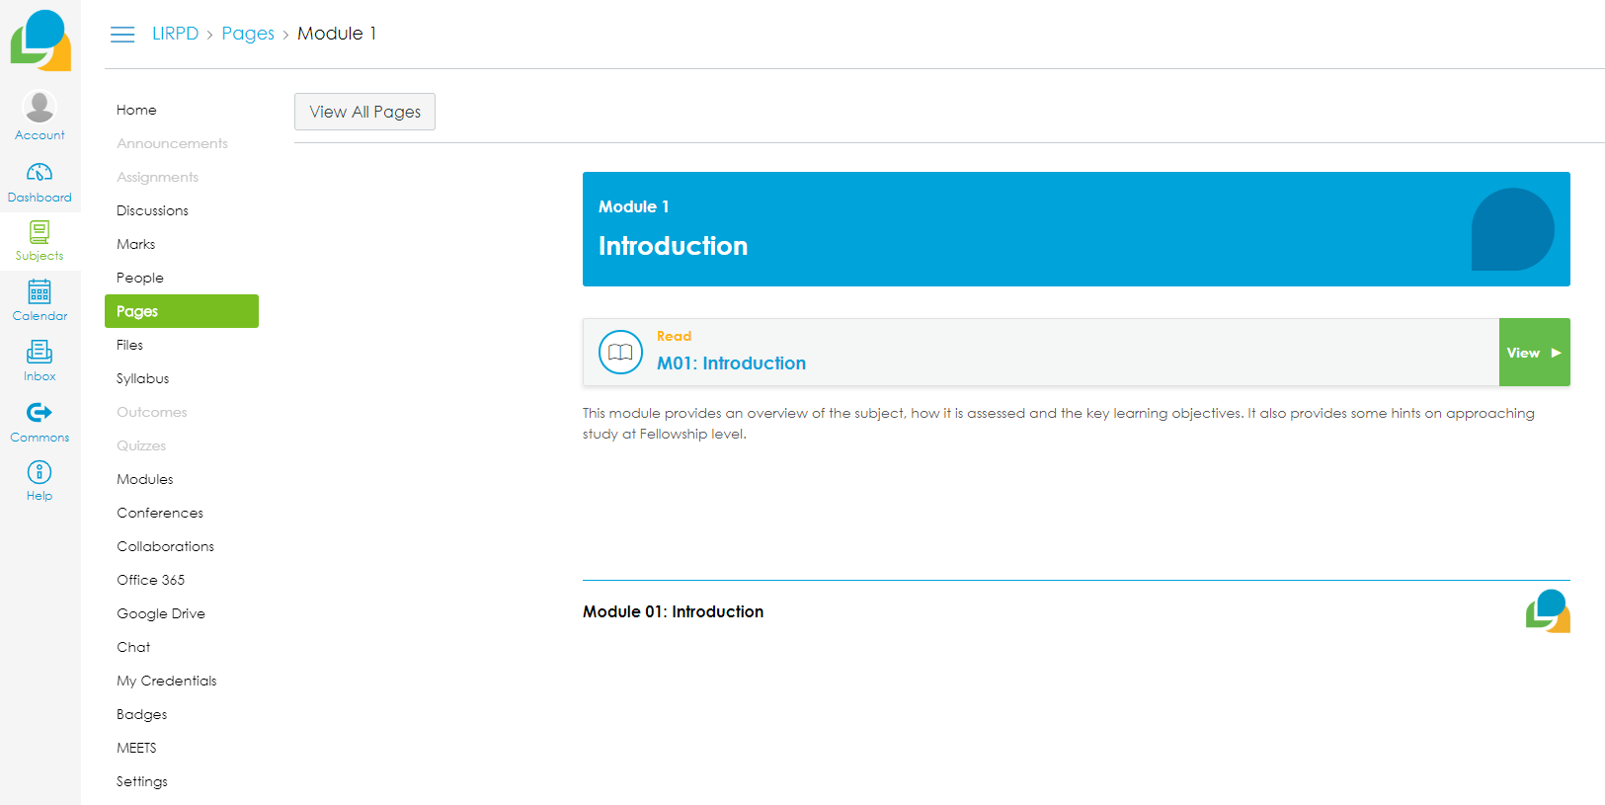
Click on a module to access notes, videos etc

Slide 8
More Information
Introduction to Canvas for Students
https://vimeo.com/74677642
To answer your specific questions consult the Canvas Student Guide : https://community.canvaslms.com/docs/DOC-10701

